Slide 1

The Role of CCyB and Forward Looking Perspectives
Vladimir Yeghiazaryan, Arthur Grigoryan
Central Bank of Armenia

Slide 2
Overview
CCyB requires banks to hold additional capital during periods of excessive credit growth and to release it during periods of stress, thus smoothing out credit cycles.
The level of CCyB should be relative to the amount of accumulated risk within the system. The buffers should be increased before the existing risks are realized.

Slide 3
Decision criteria
Changes in financial cycle
Early warning indicators and recent developments
Quantitative analysis (fin cycle-based measures, stress testing)
Decision within the department based on expert judgment
Scenario discussion and approval at the Board meeting
Decision comes into force after 6 months (to minimize inaction bias and maintain resilience)
Notes:
The costs of a type 1 error (no CCyB when it is necessary) are higher than that of a type 2 error – a CCyB when it is not necessary (Galan, 2020)

Slide 4
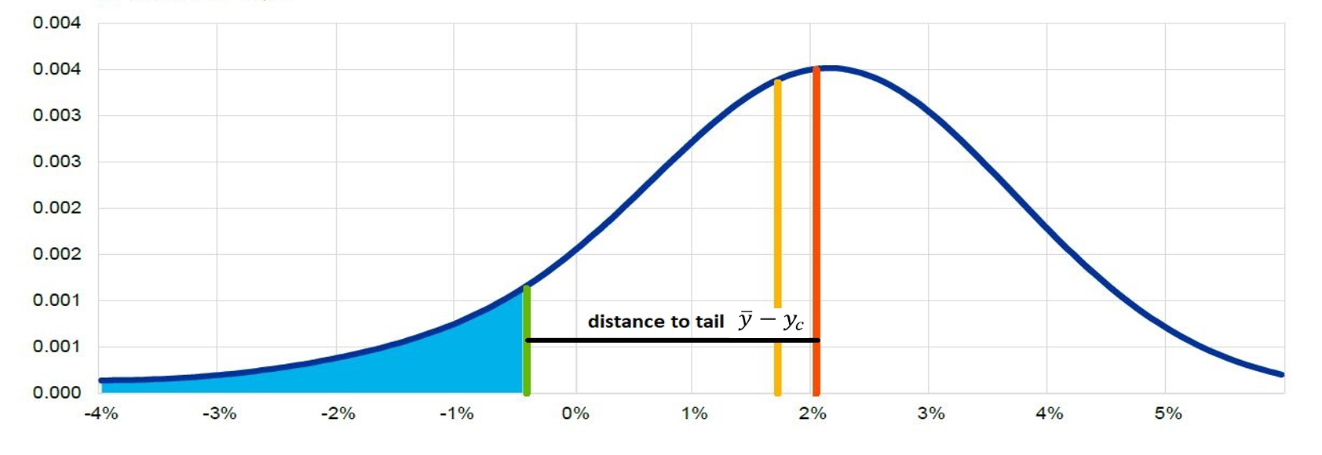
Compliments to CCyB framework
Main criticism to CCyB:
short-term costs
uncertainties concerning long-term benefits
Solution:
Quantify uncertainty by capturing the effects of policy on the entire distribution of GDP using the Growth at Risk (GaR) framework.
optimal rate is a result between the distance to tail and the mean

Slide 5
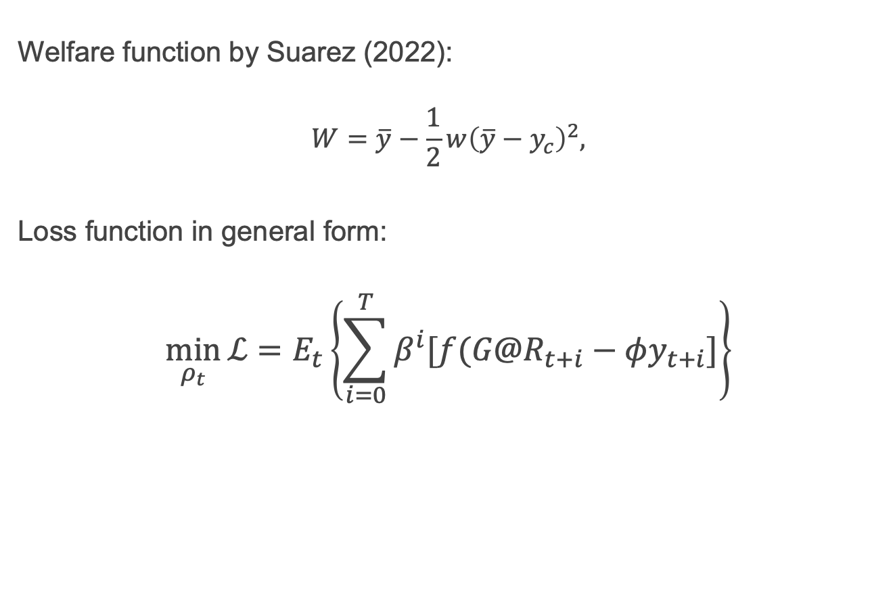
GaR Loss Function
Welfare function by Suarez (2022):
$$W=\overline{y}−\frac{1}{2}w{\left(\overline{y}−y_{c}\right)}^{2},$$
Loss function in general form:
$$\min_{ρ_{t}}{\text{ℒ}}=E_{t}\left\{\sum_{i=0}^{T}{β^{i}[f(G@R_{t+i}−φy_{t+i}]}\right\}$$

Slide 6
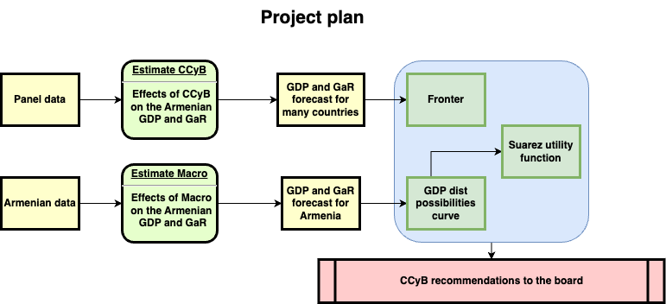
GaR WIP
Data sources:
IMF (FSI and IFS)
World Bank
TradingView (for Gov bond data)
OECD (house prices)

Slide 7
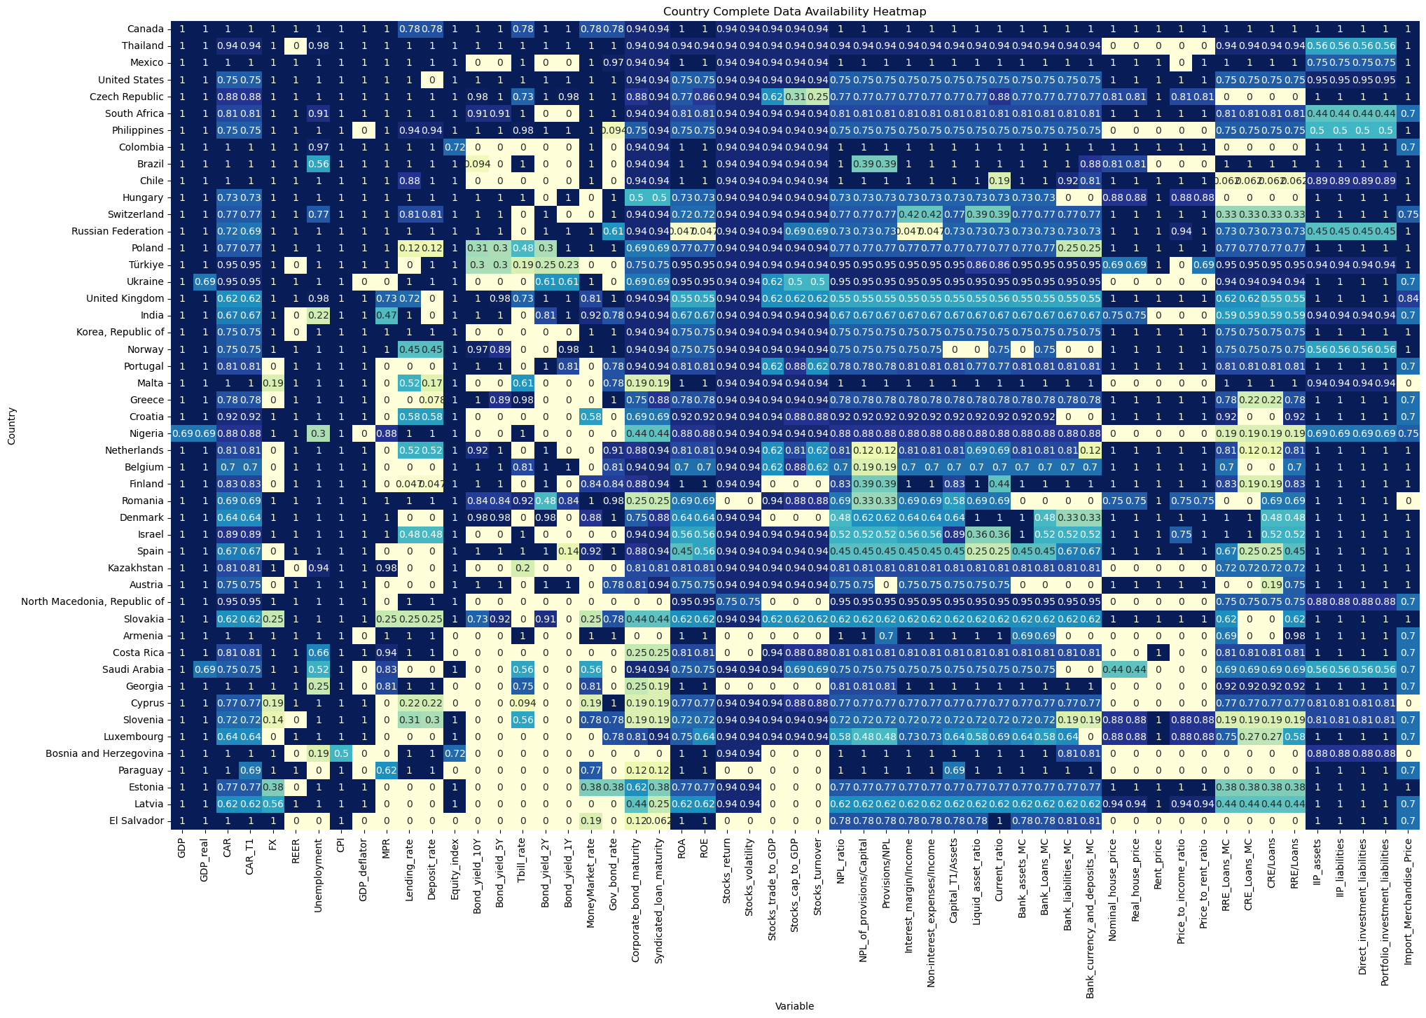
GaR WIP: data cleanup
Integrated dataset details:
58 variables and 48 countries.
Available data accounted for the 70.86% of the cells.
The rest of the cells were filled using a matrix completion algorithm.

Slide 8
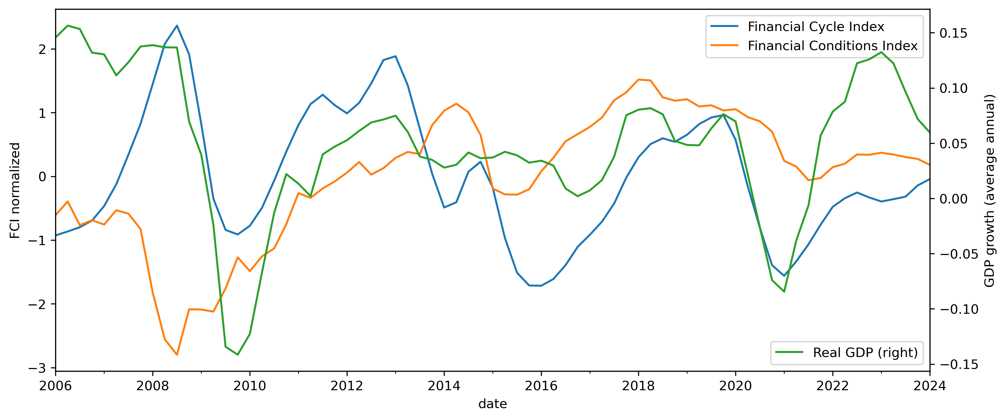
Financial vulnerabilities, stress and real GDP growth

Slide 9
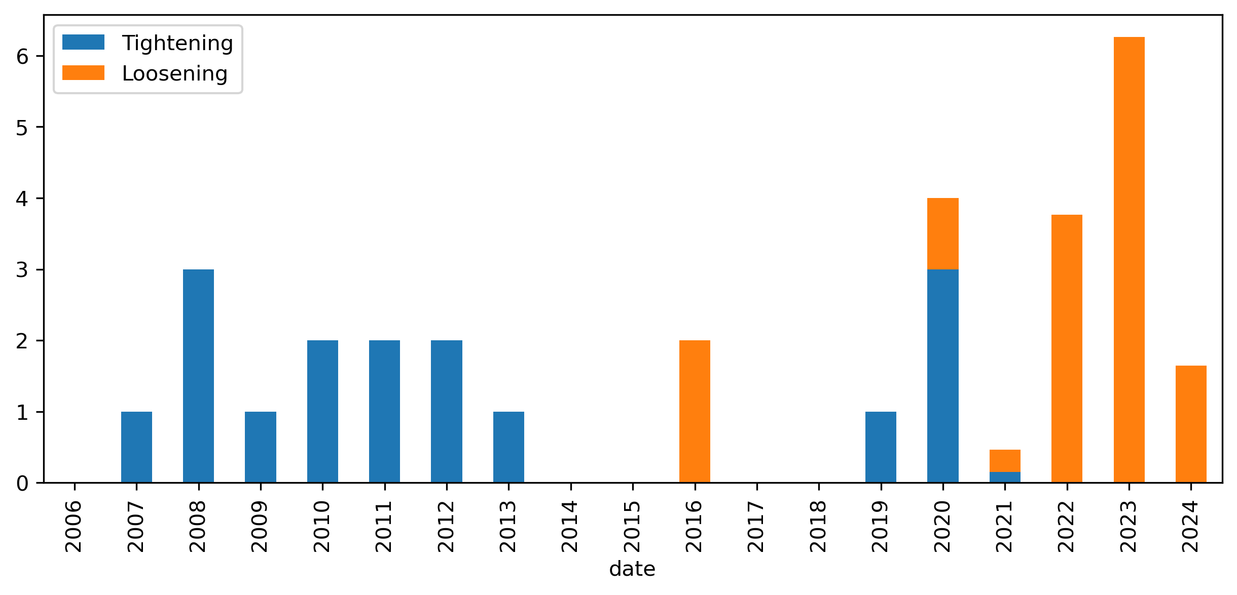
Macroprudential policy response

Slide 10
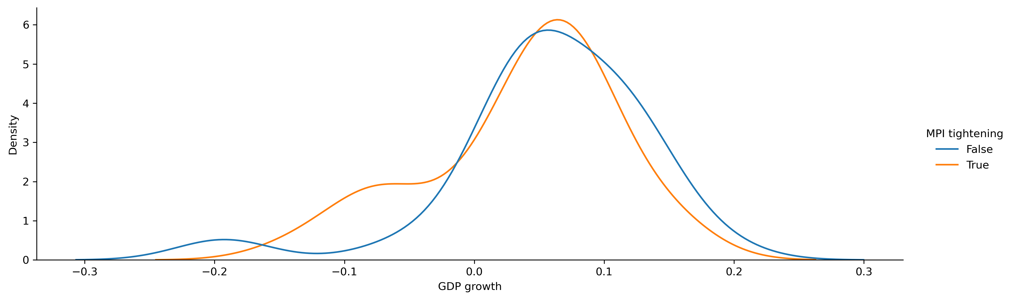
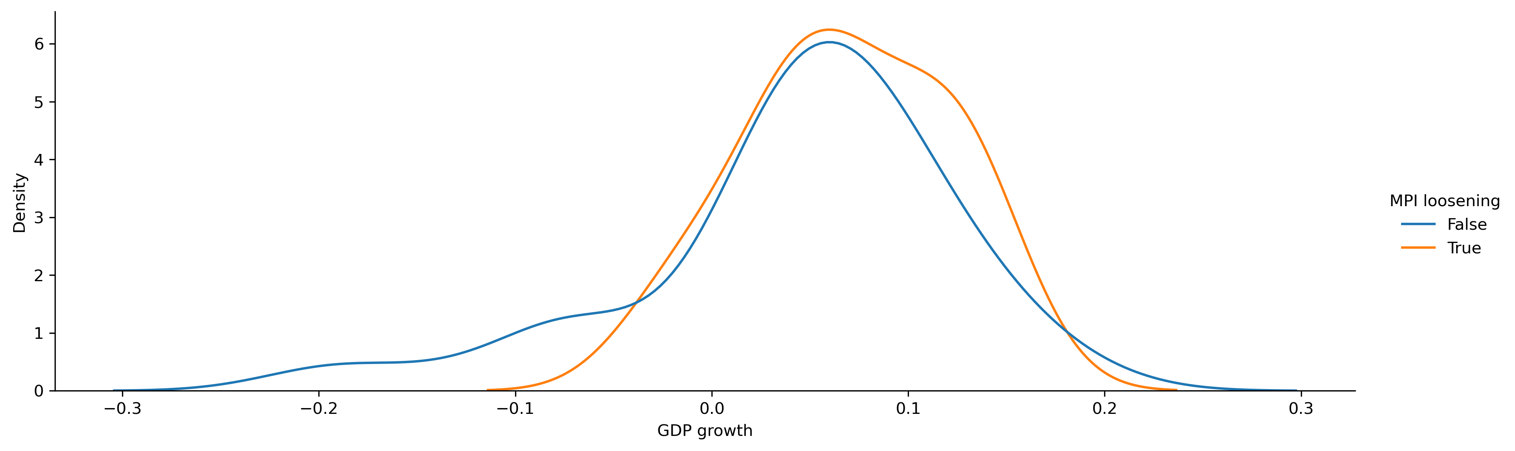
Macroprudential policy response

Slide 11
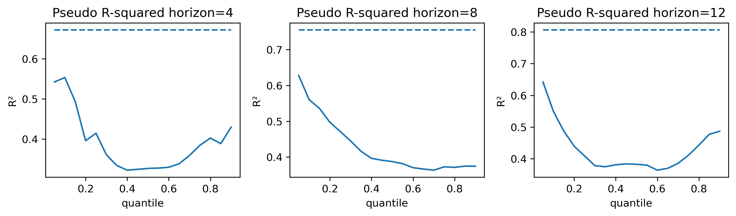
Pseudo r-squared for quantile regression estimates across quantiles and horizons

Slide 12
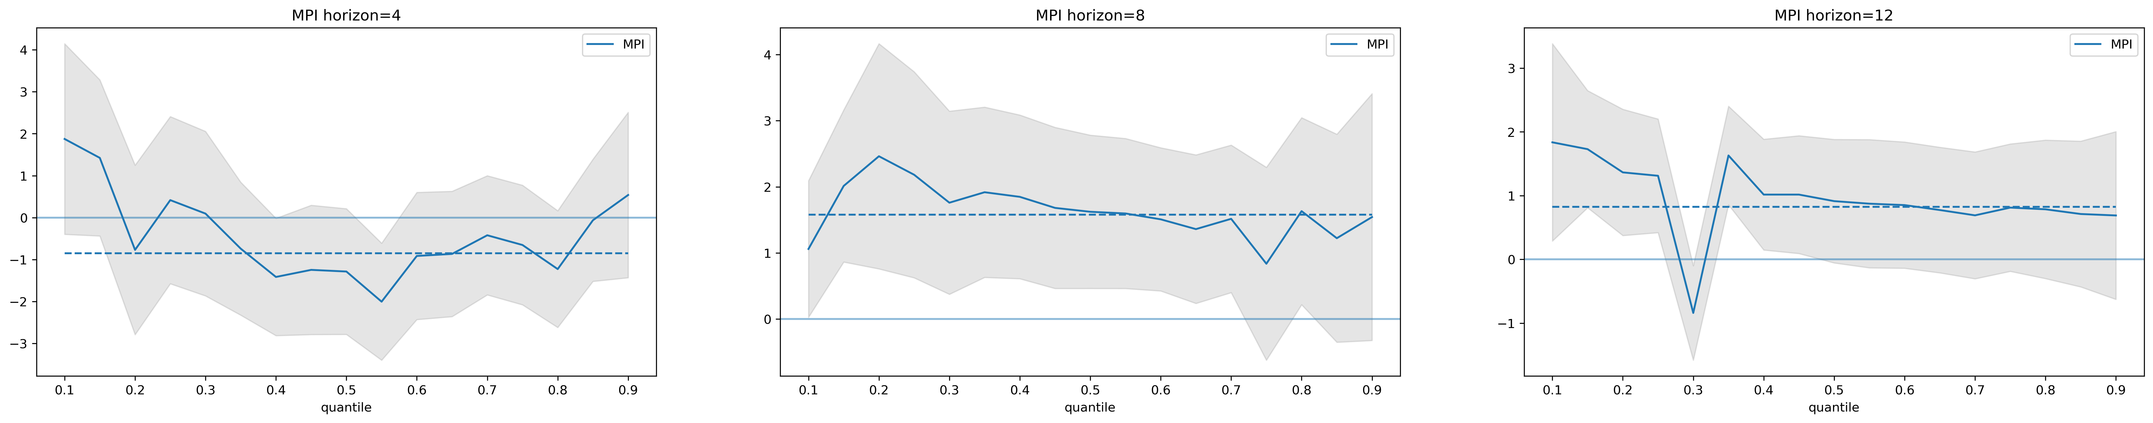
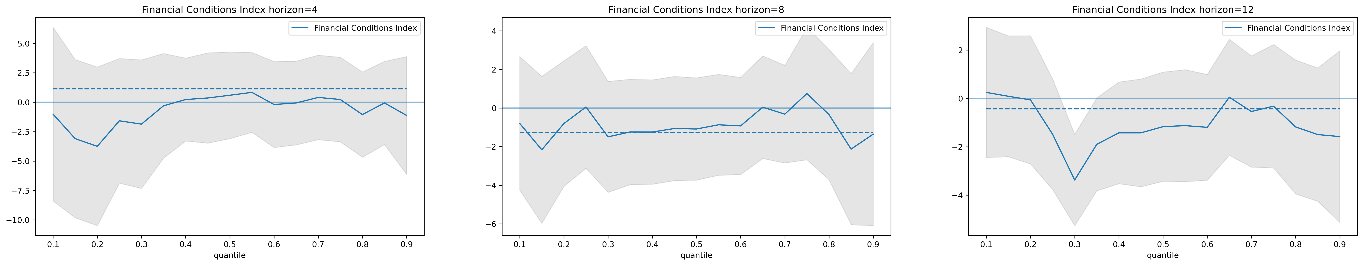
MPI and FCI effect across different quantiles and horizons

Slide 13
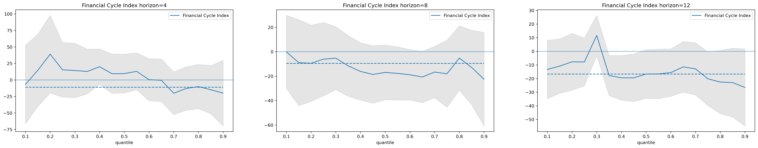
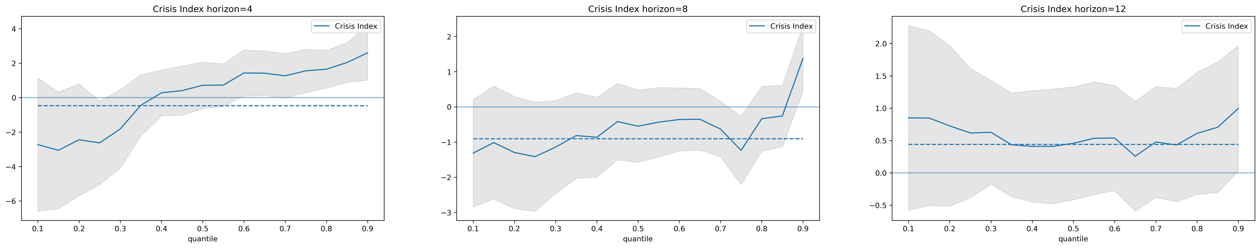
FCyI and CI effect across different quantiles and horizons

Slide 14
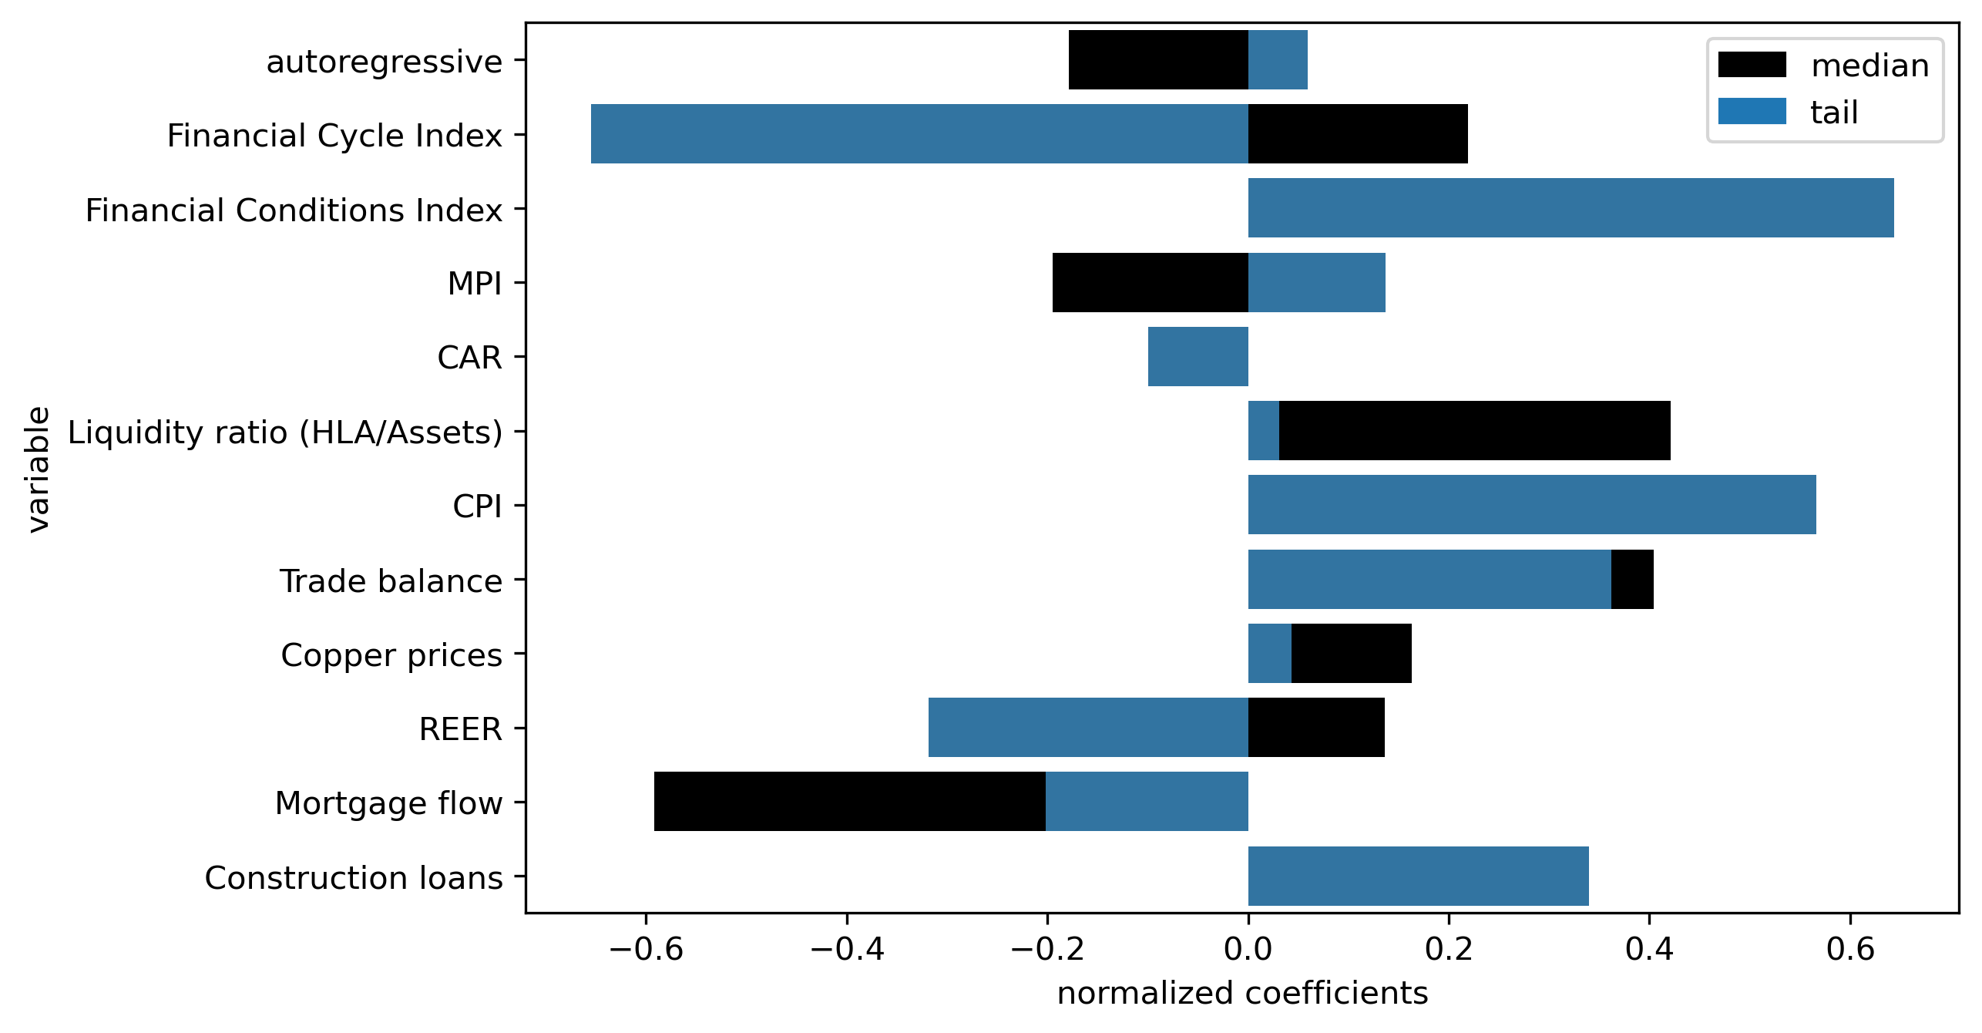
Normalized quantile regression coefficients for horizon 4

Slide 15
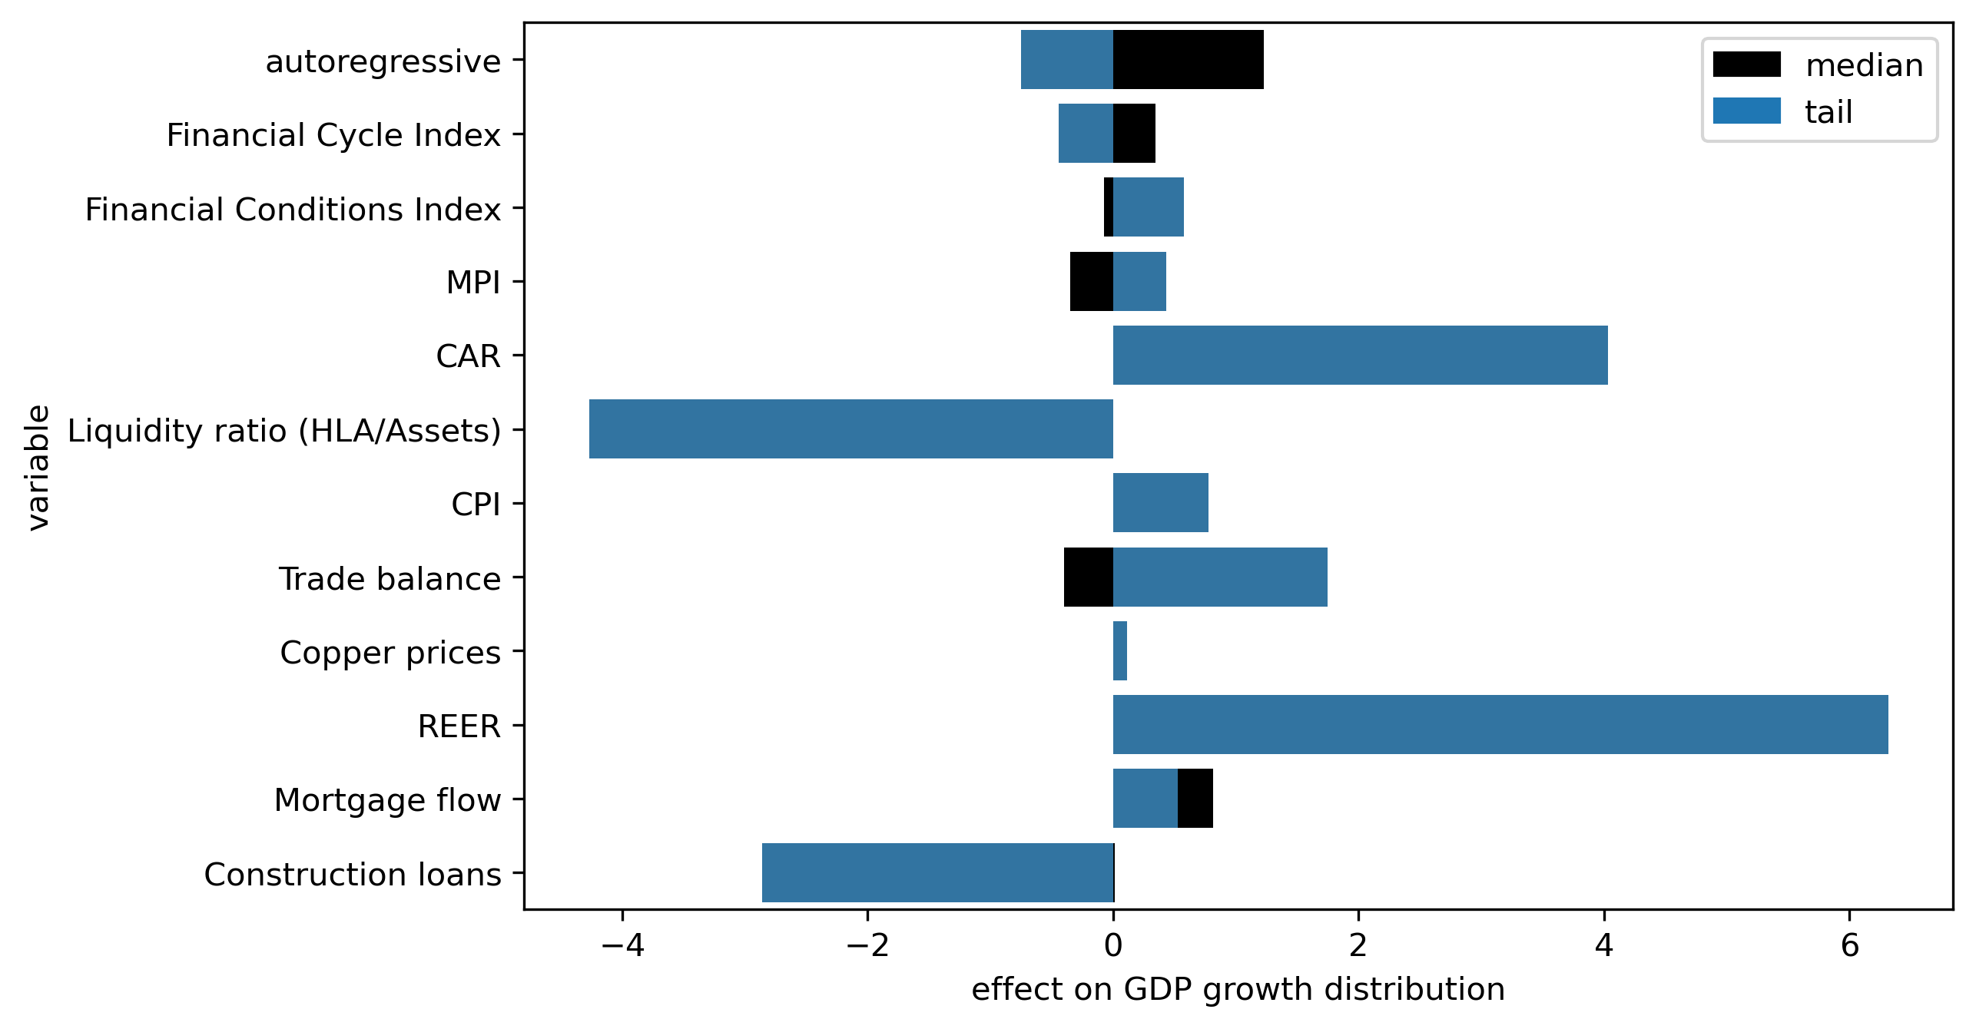
Effects of the variables on GDP growth dist. for the 1 year ahead forecast scenario (2025Q1)

Slide 16
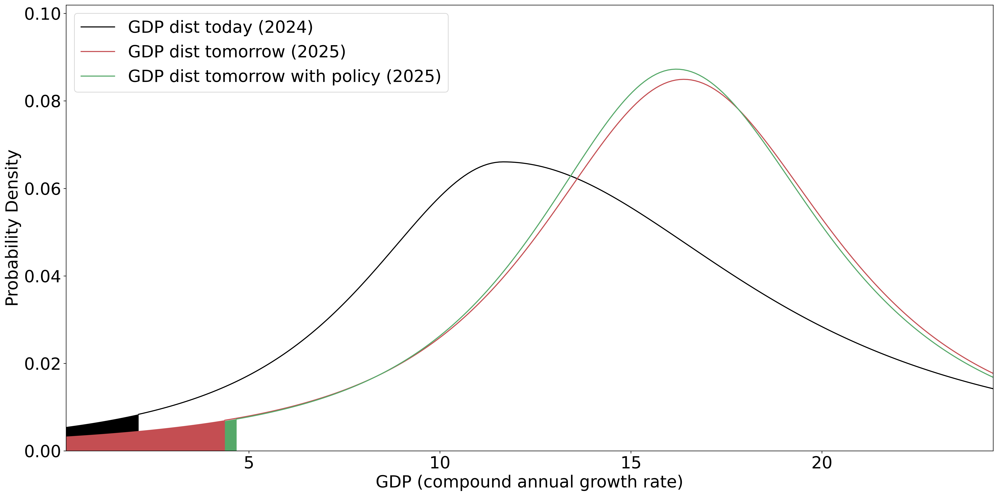
One year ahead GDP distribution forecast and optimal policy calibration

Slide 17
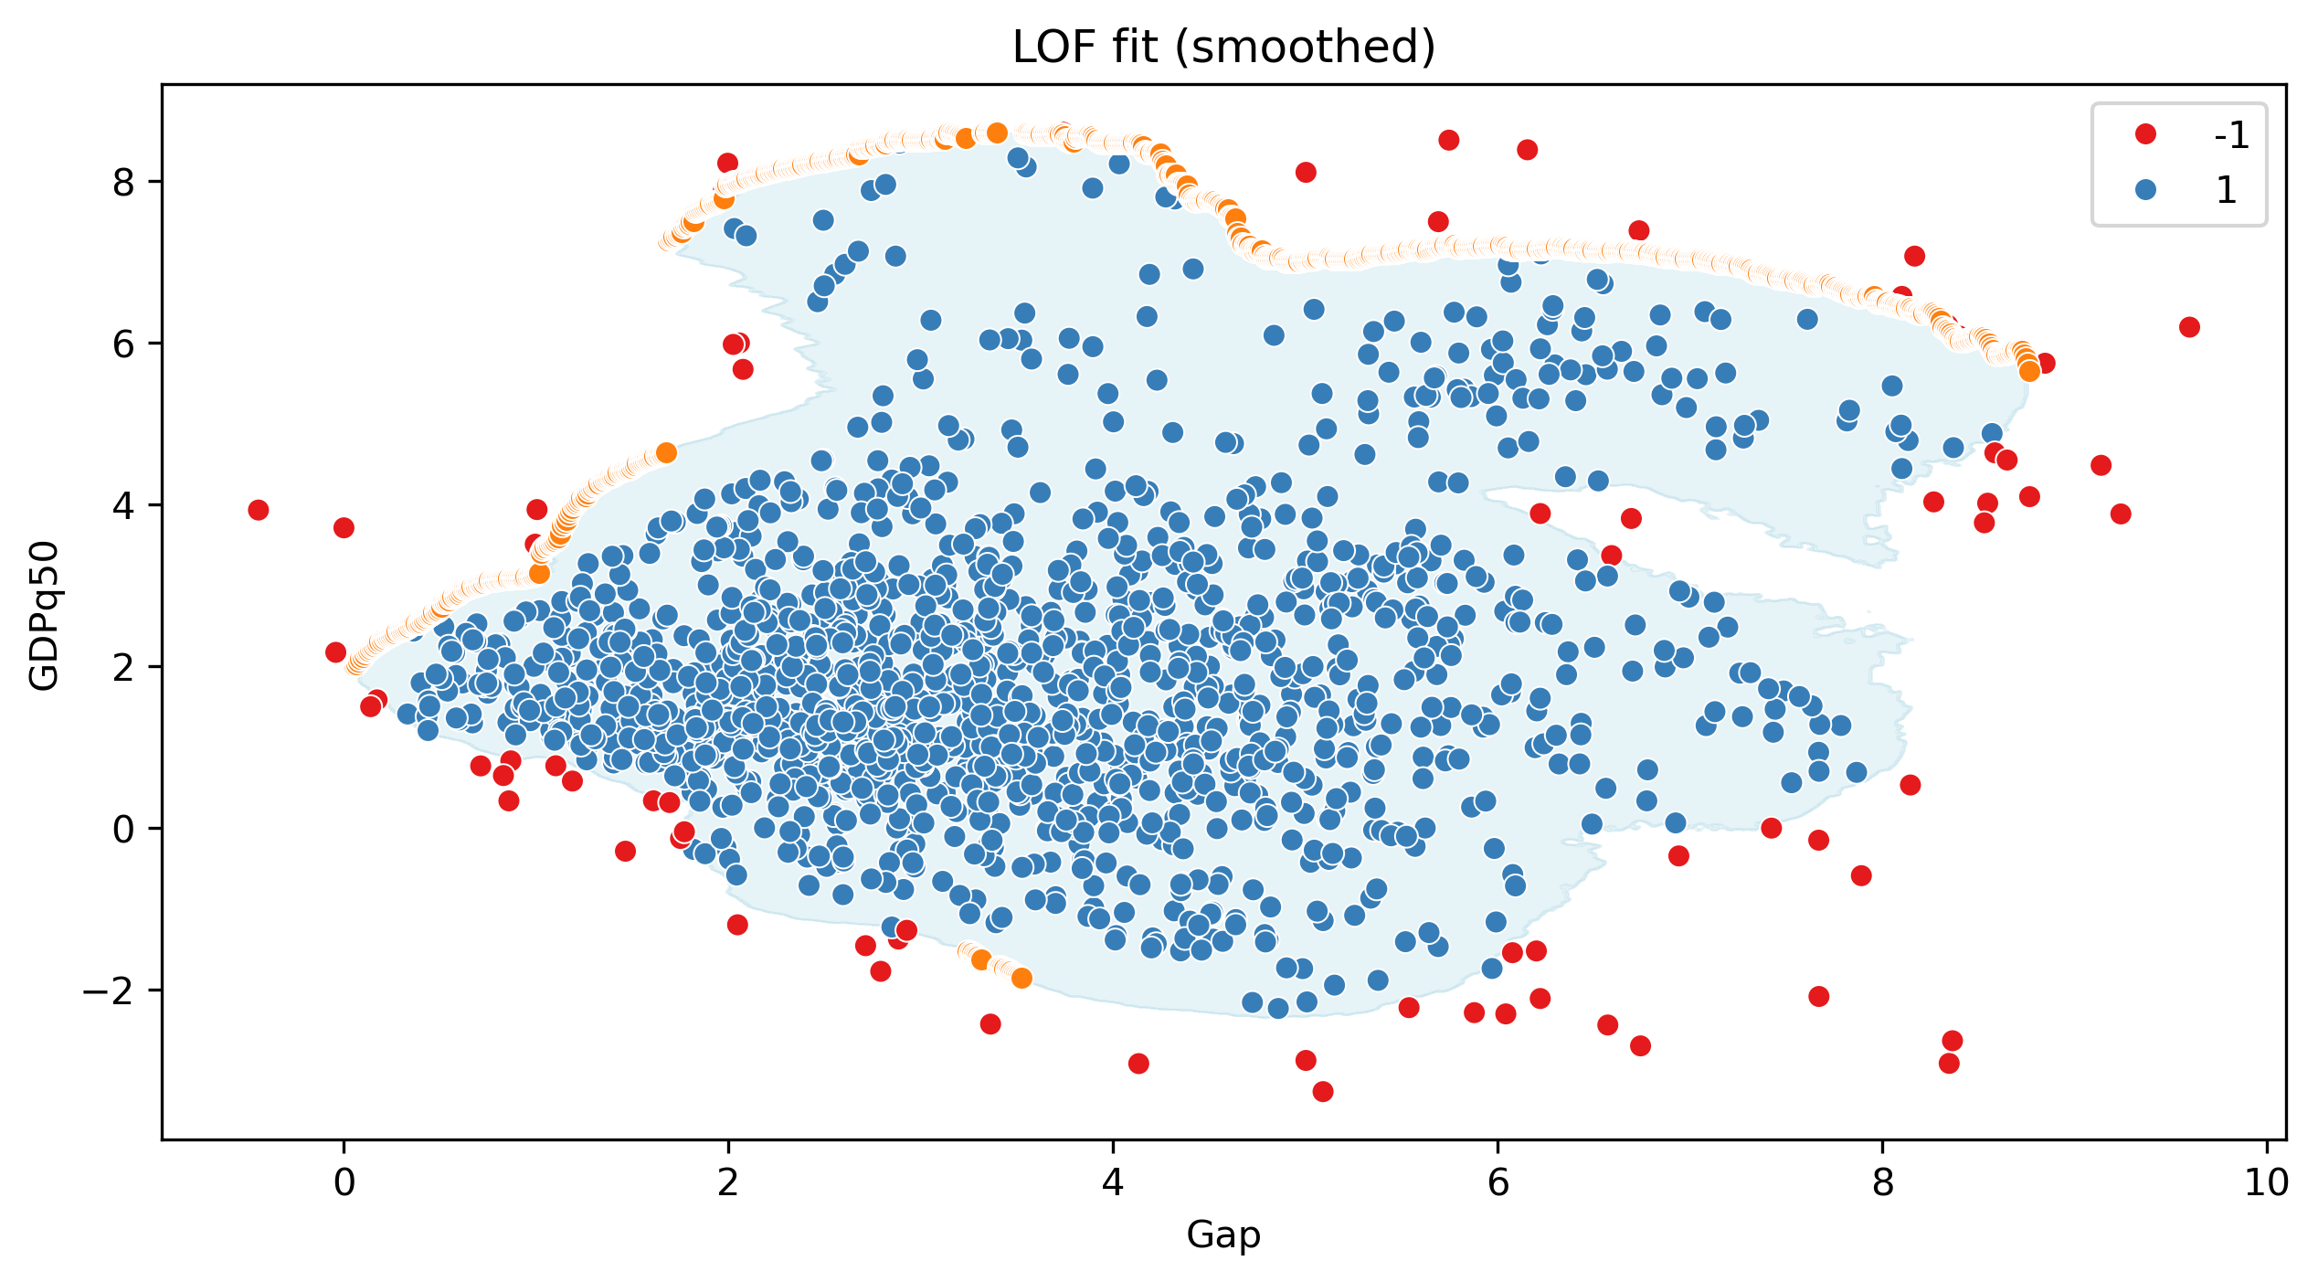
GaR WIP: Frontier boundary

Slide 18
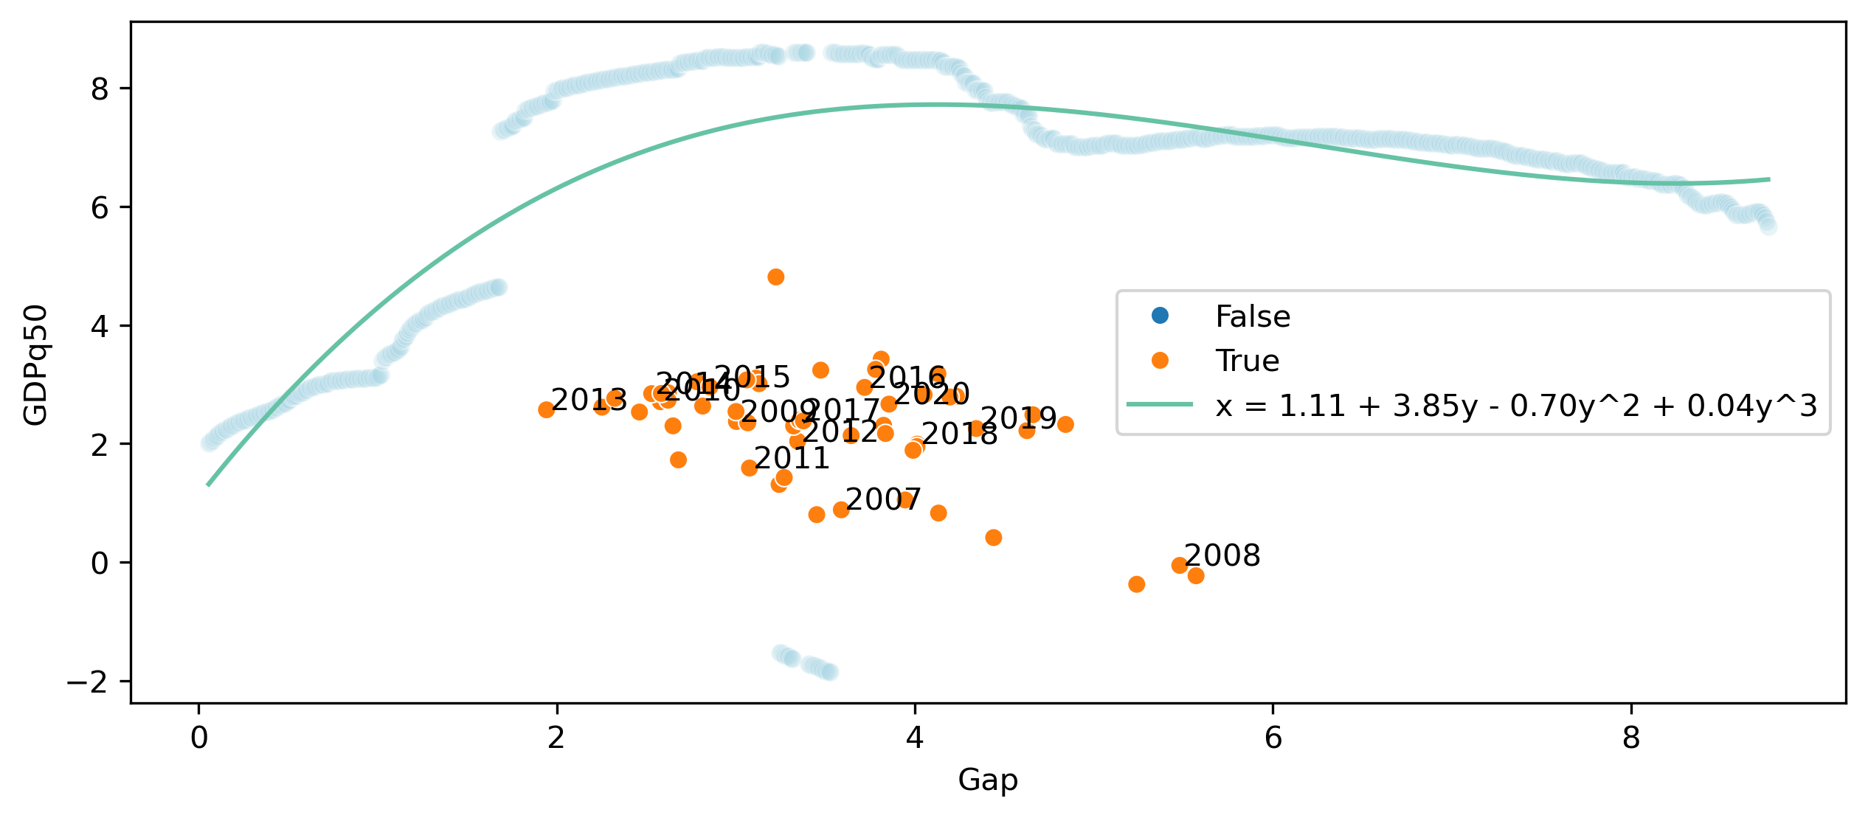
GaR WIP: Frontier boundary

Slide 19
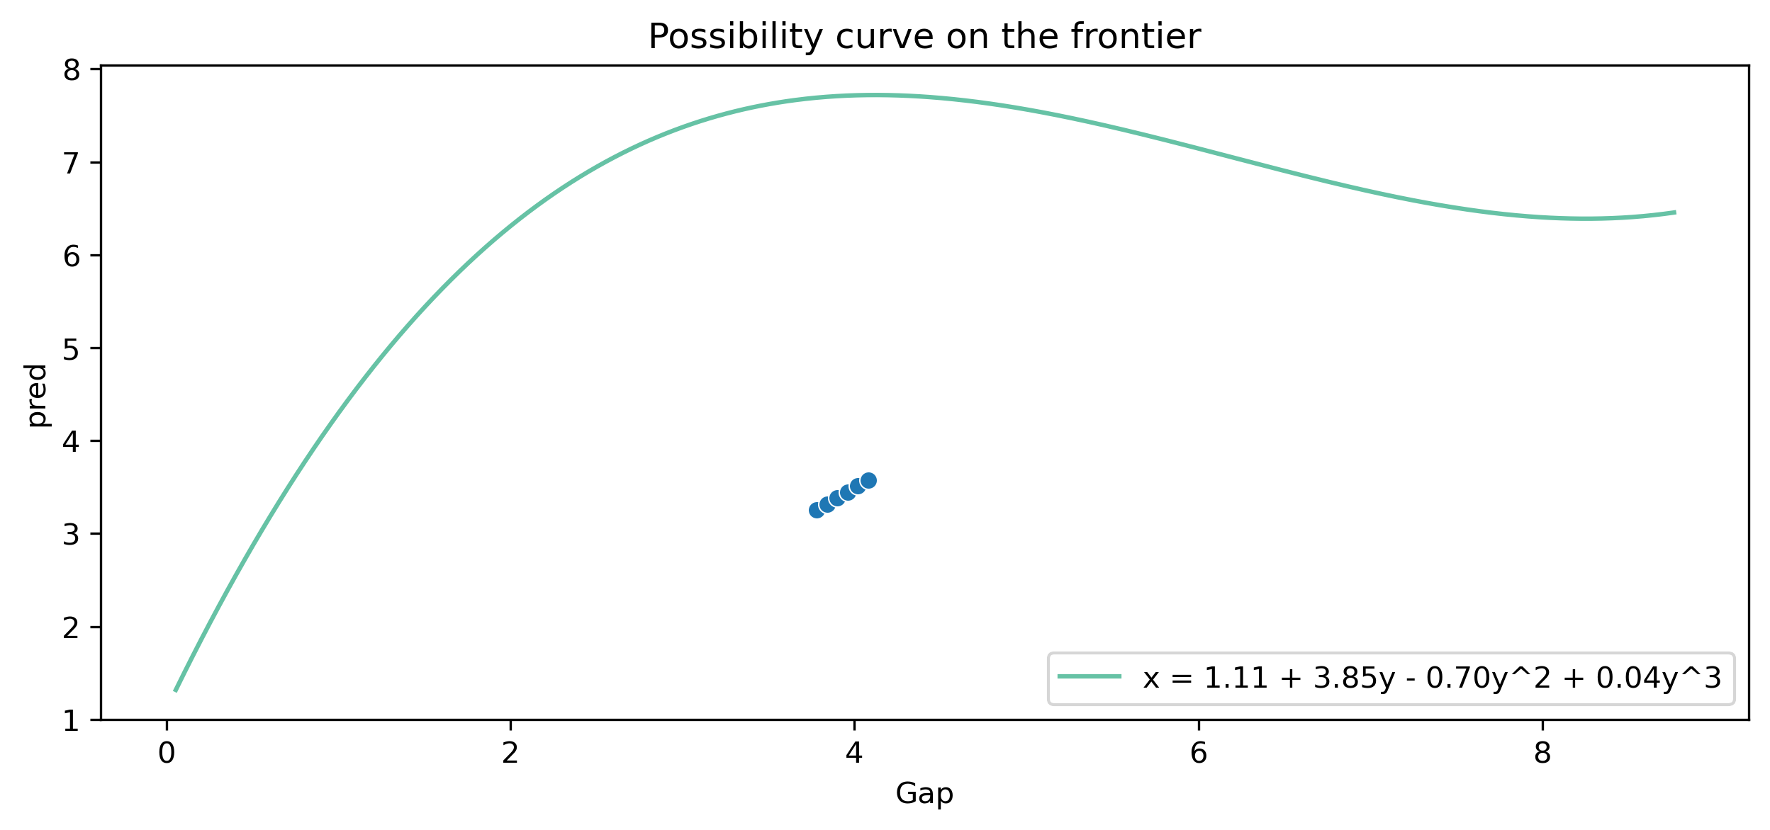
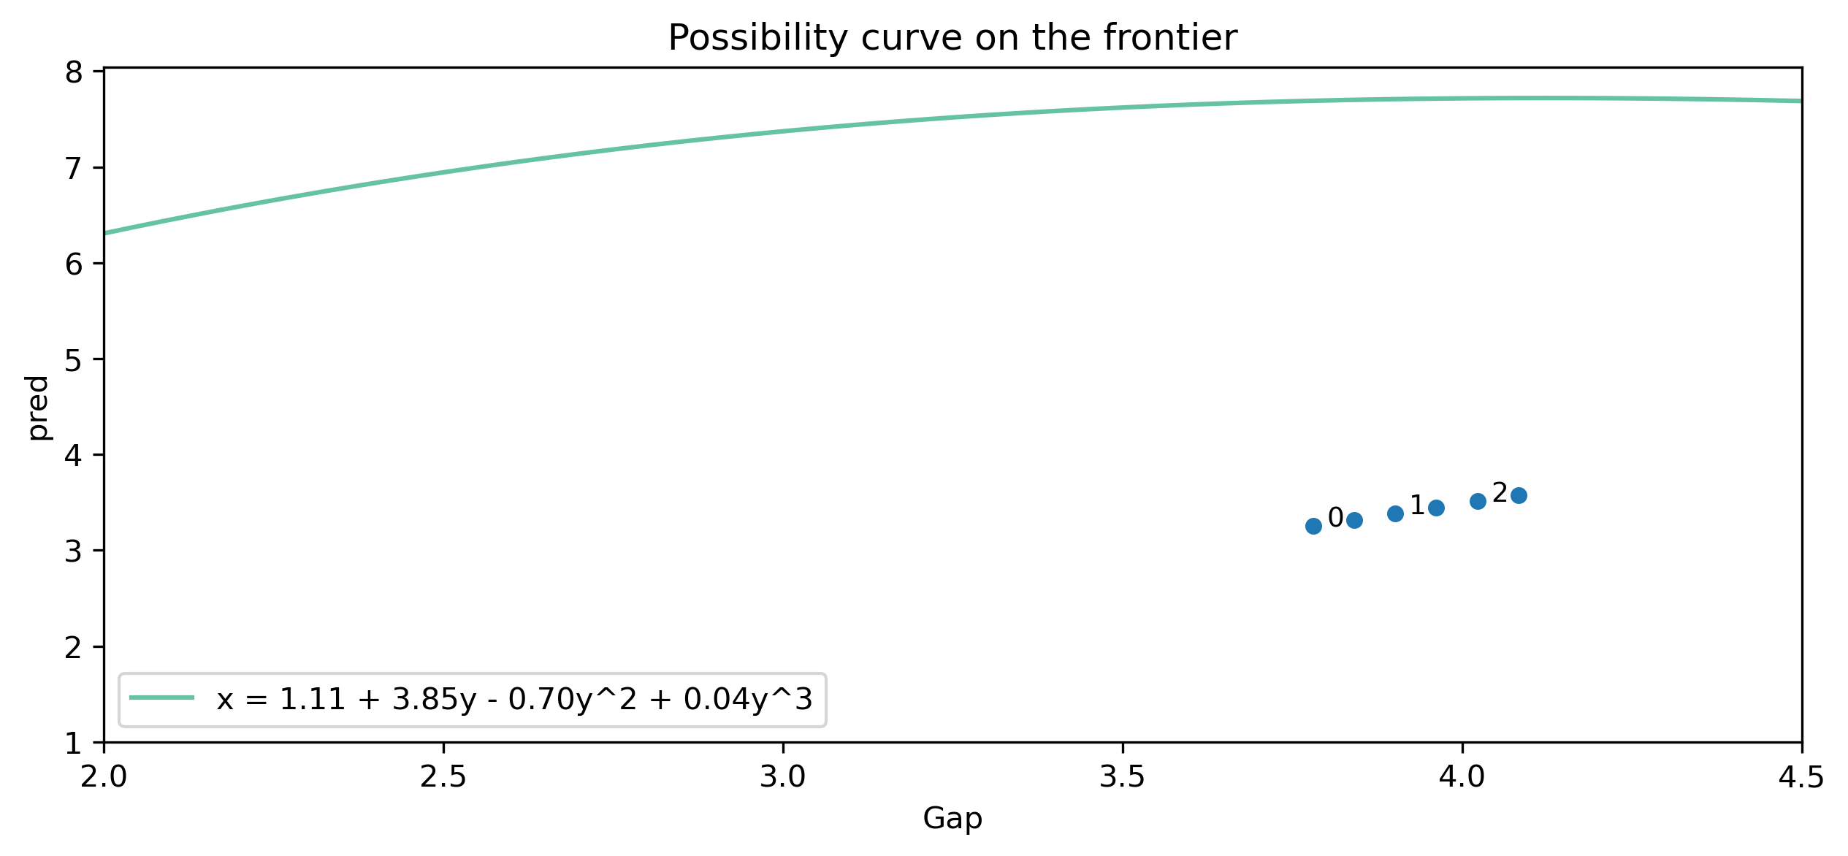
GaR WIP: possibility curve
Short term (1 year)
Long term (2 years)

Slide 20
Forward-looking policy
Rule based decision making framework:
Stable phase of cycle: neutral rate
Expansion and Peak of cycle: optimal rate based on GaR
Contraction: release

Slide 21
Thank you

